Slide 1

Modeling V

Slide 2
Introduction
Fiercely Read Chapter 18 (R4DS)
Previously: Numeric Variables
New Focus
Categorical Predictor Variables
Interaction Effects
Different Categorical Variables
Principled
Arbitrary
Understand Using Multiple Datasets and Visualizations

Slide 3
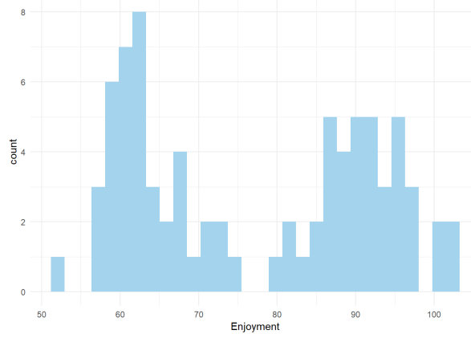
Example 1
Data Overview
Enjoyment (E)
Food (F)
Condiment (C)
80 Observations
Enjoyment Visualized

Slide 4
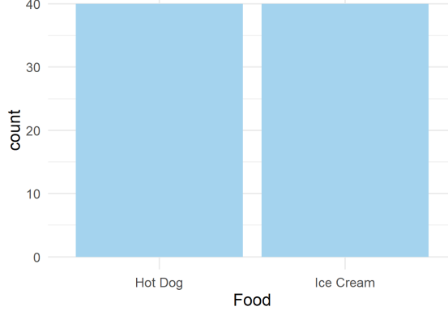
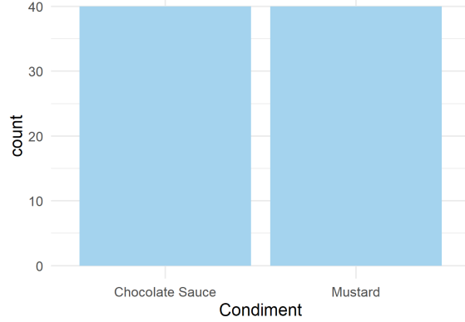
Example 1
Food Visualized
Condiment Visualized

Slide 5
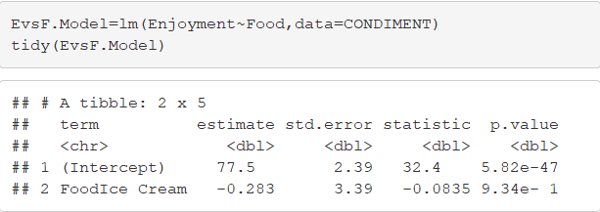
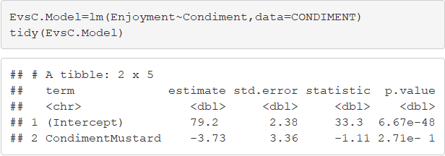
Example 1
Regressing E on C
Regressing E on F

Slide 6
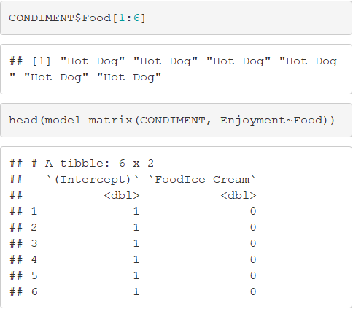
Example 1
What is R Doing?

Slide 7
Closing
Disperse and Make Reasonable Decisions

